Slide 1
Lecture 17
CTMC – Steady State Analysis

Slide 2
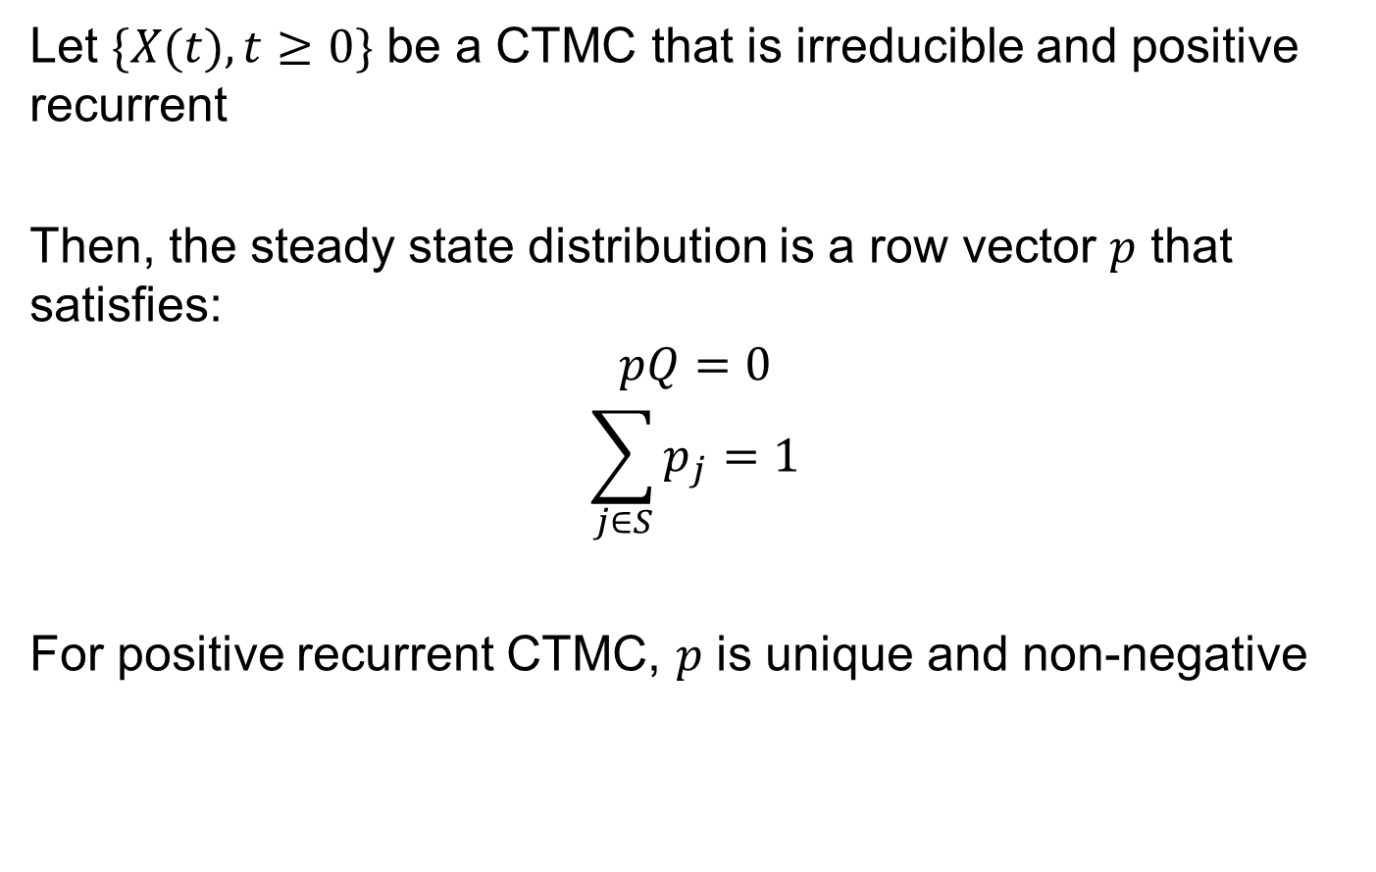
Steady State Distribution
Let $\{X(t),t≥0\}$ be a CTMC that is irreducible and positive recurrent
Then, the steady state distribution is a row vector $p$ that satisfies:
$$pQ=0$$
$$\sum_{j∈S}{p_{j}}=1$$
For positive recurrent CTMC, $p$ is unique and non-negative

Slide 3
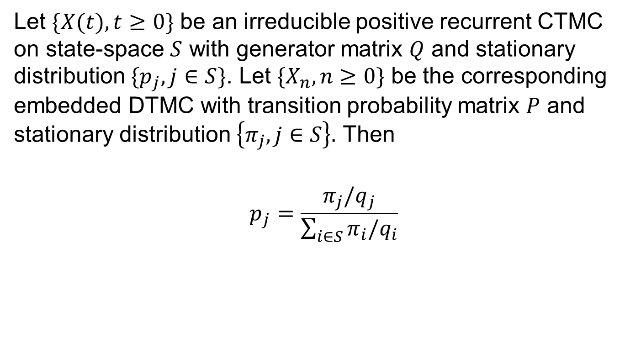
CTMC and embedded DTMC
Let $\{X(t),t≥0\}$ be an irreducible positive recurrent CTMC on state-space $S$ with generator matrix $Q$ and stationary distribution $\{p_{j},j∈S\}$. Let $\{X_{n}, n≥0\}$ be the corresponding embedded DTMC with transition probability matrix $P$ and stationary distribution $\left\{π_{j},j∈S\right\}.$ Then
$$p_{j}=\frac{π_{j}/q_{j}}{\sum_{i∈S}{π_{i}/q_{i}}}$$

Slide 4
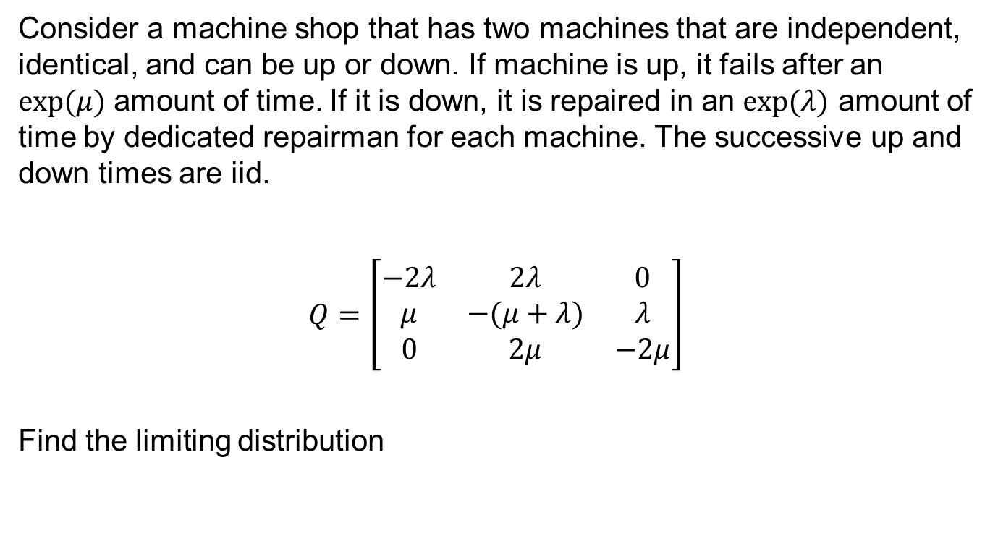
Two Machine Example
Consider a machine shop that has two machines that are independent, identical, and can be up or down. If machine is up, it fails after an $exp(μ)$ amount of time. If it is down, it is repaired in an $exp(λ)$ amount of time by dedicated repairman for each machine. The successive up and down times are iid.
$Q=\left[\begin{matrix}−2λ & 2λ & 0 \\ μ & −(μ+λ) & λ \\ 0 & 2μ & −2μ\end{matrix}\right]$
Find the limiting distribution

Slide 5

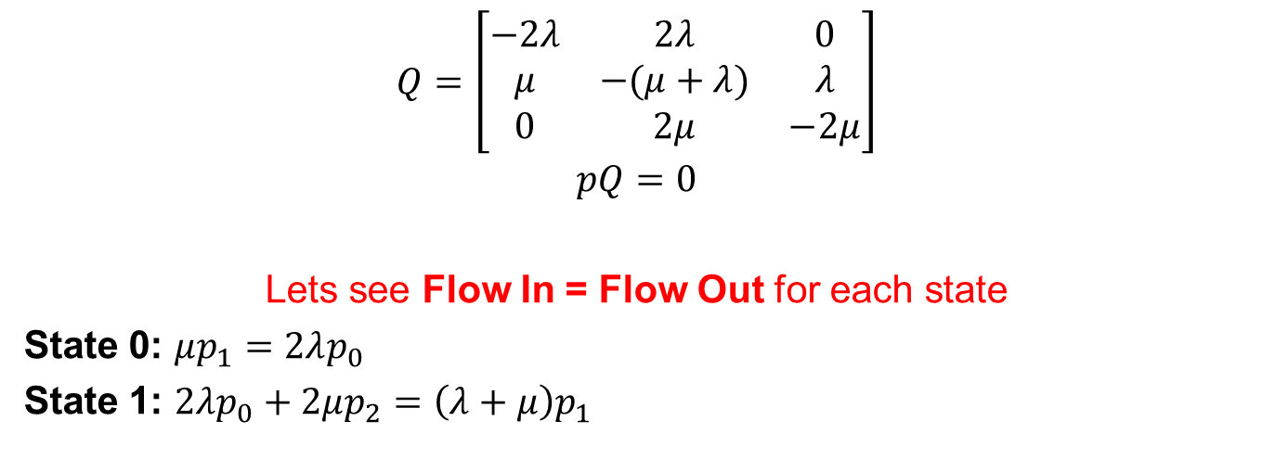



Two Machine Example
$$2λ$$
$$λ$$
0
1
2
$$μ$$
$$2μ$$
$$Q=\left[\begin{matrix}−2λ & 2λ & 0 \\ μ & −(μ+λ) & λ \\ 0 & 2μ & −2μ\end{matrix}\right]$$
$$pQ=0$$
Lets see Flow In = Flow Out for each state
State 0: $μp_{1}=2λp_{0}$
State 1: $2λp_{0}+2μp_{2}=\left(λ+μ\right)p_{1}$

Slide 6



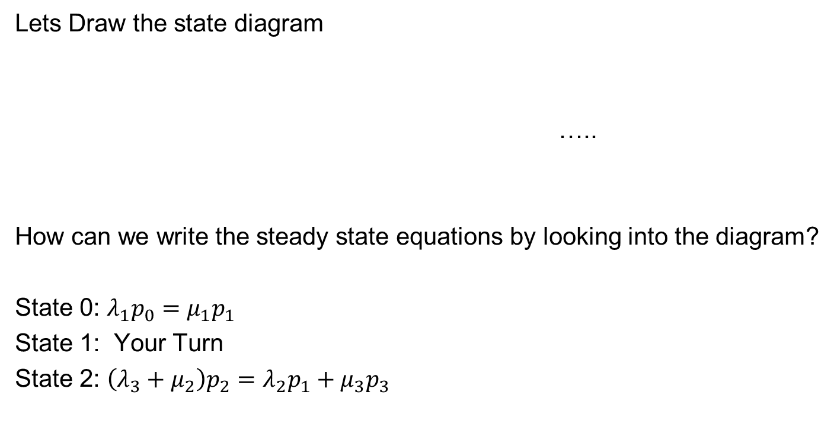



Birth Death Process
Lets Draw the state diagram
…..
How can we write the steady state equations by looking into the diagram?
State 0: $λ_{1}p_{0}=μ_{1}p_{1}$
State 1: Your Turn
State 2: $\left(λ_{3}+μ_{2}\right)p_{2}=λ_{2}p_{1}+μ_{3}p_{3}$
$$λ_{1}$$
$$λ_{2}$$
$$λ_{3}$$
0
1
2
$$μ_{1}$$
$$μ_{2}$$
$$μ_{3}$$

Slide 7
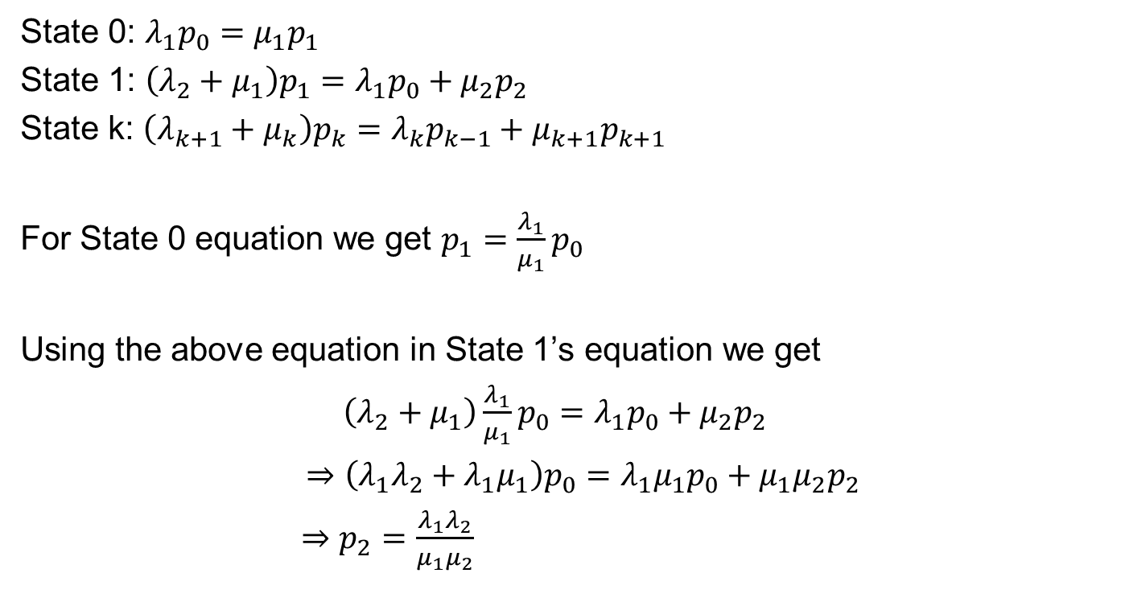
Birth Death Process
State 0: $λ_{1}p_{0}=μ_{1}p_{1}$
State 1: $\left(λ_{2}+μ_{1}\right)p_{1}=λ_{1}p_{0}+μ_{2}p_{2}$
State k: $\left(λ_{k+1}+μ_{k}\right)p_{k}=λ_{k}p_{k−1}+μ_{k+1}p_{k+1}$
For State 0 equation we get $p_{1}=\frac{λ_{1}}{μ_{1}}p_{0}$
Using the above equation in State 1’s equation we get
$\left(λ_{2}+μ_{1}\right)\frac{λ_{1}}{μ_{1}}p_{0}=λ_{1}p_{0}+μ_{2}p_{2}$
$⇒\left({λ_{1}λ}_{2}+{λ_{1}μ}_{1}\right)p_{0}=λ_{1}μ_{1}p_{0}+{μ_{1}μ}_{2}p_{2}$
$⇒p_{2}=\frac{λ_{1}λ_{2}}{μ_{1}μ_{2}}$

Slide 8
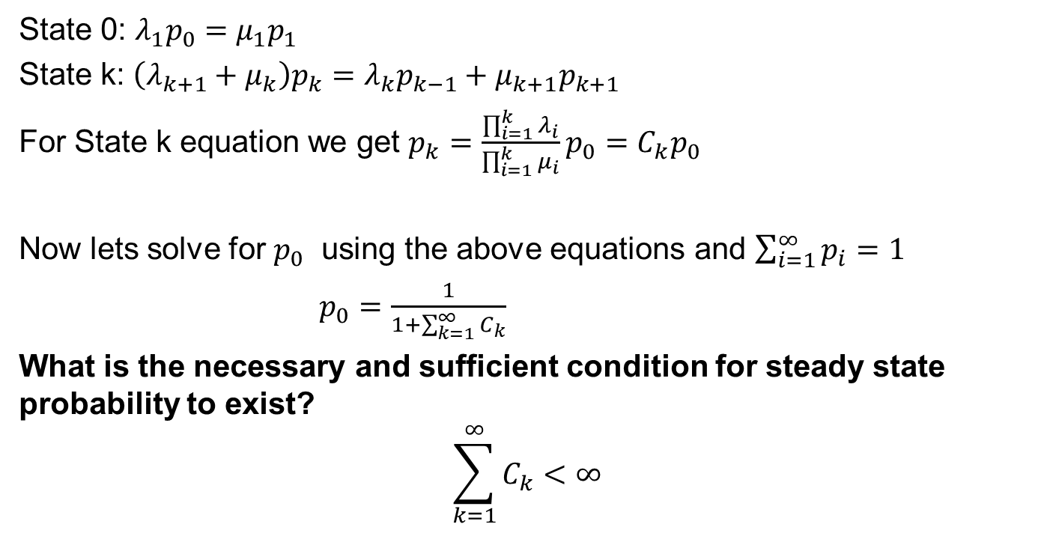
Birth Death Process
State 0: $λ_{1}p_{0}=μ_{1}p_{1}$
State k: $\left(λ_{k+1}+μ_{k}\right)p_{k}=λ_{k}p_{k−1}+μ_{k+1}p_{k+1}$
For State k equation we get $p_{k}=\frac{\prod_{i=1}^{k}{λ_{i}}}{\prod_{i=1}^{k}{μ_{i}}}p_{0}=C_{k}p_{0}$
Now lets solve for $p_{0}$ using the above equations and $\sum_{i=1}^{∞}{p_{i}=1}$
$p_{0}=\frac{1}{1+\sum_{k=1}^{∞}{C_{k}}}$
What is the necessary and sufficient condition for steady state probability to exist?
$$\sum_{k=1}^{∞}{C_{k}<∞}$$

Slide 9

Birth Death Process – Special Case
Let $λ_{i}=λ, μ_{i}=μ, ∀i$
For State k equation we get $p_{k}=\frac{λ^{k}}{μ^{k}}p_{0}=C_{k}p_{0}$
Now lets solve for $p_{0}$ using the above equations and $\sum_{i=1}^{∞}{p_{i}=1}$
$p_{0}=\frac{1}{1+\sum_{k=1}^{∞}{C_{k}}}$
If $\frac{λ}{μ}<1$, then $p_{0}=1−\frac{λ}{μ}=1−ρ$

Slide 10
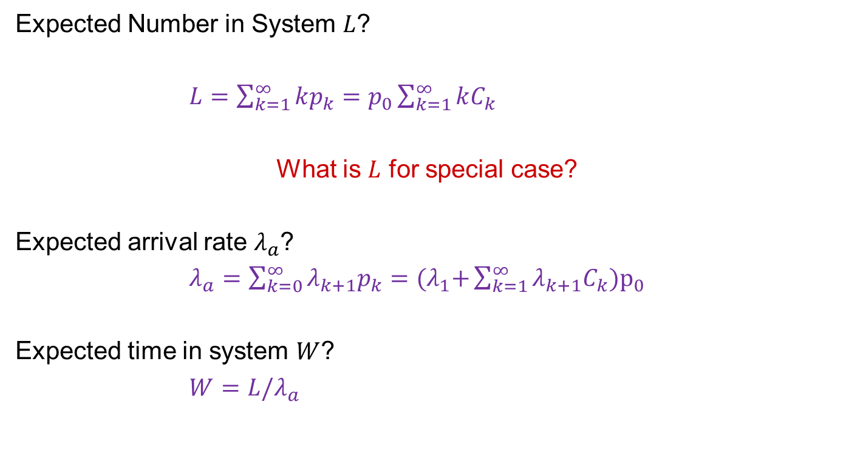
Birth Death Process - Properties
Expected Number in System $L$?
$L=\sum_{k=1}^{∞}{kp_{k}=p_{0}\sum_{k=1}^{∞}{kC_{k}}}$
What is $L$ for special case?
Expected arrival rate $λ_{a}$?
$λ_{a}=\sum_{k=0}^{∞}{λ_{k+1}p_{k}={(λ}_{1}+\sum_{k=1}^{∞}{λ_{k+1}C_{k}}})p_{0}$
Expected time in system $W$?
$W=L/λ_{a}$

Slide 11

Birth Death Process - Properties
Let $T_{i}$ be the time starting from state $i$ to enter state $i+1$
$${E(T}_{0})=1/λ_{i}$$
Formula for moment of $T$ can be applied here
In general $Bm\left(k\right)+km\left(k−1\right)=0, k≥1$
$$λ_{1}$$
$$λ_{2}$$
$$λ_{3}$$
0
1
2
$$μ_{1}$$
$$μ_{2}$$
$$μ_{3}$$

Slide 12
ATM Example
Five persons can be in the foyer of a bank ATM machine. Assume that customers won't enter when the foyer is full. Past data shows that the average time between arrival is 30 seconds where the average service time is 24 seconds. Now add a human teller (service time 60 seconds) to the foyer of 5 standing room in which an ATM machine is there. ATM machine is given priority when it is empty. Let's model it as a birth and death CTMC. What happens when we want to know average customers that goes to the human teller.

Slide 13



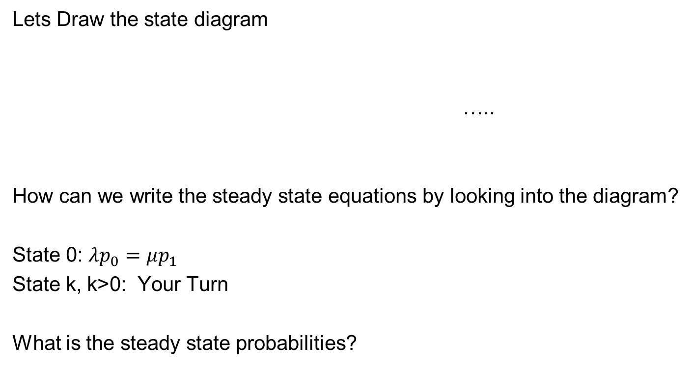



Birth Death Process with infinite servers
Lets Draw the state diagram
…..
How can we write the steady state equations by looking into the diagram?
State 0: $λp_{0}=μp_{1}$
State k, k>0: Your Turn
What is the steady state probabilities?
$$λ$$
$$λ$$
$$λ$$
0
1
2
$$μ$$
$$2μ$$
$$3μ$$

Slide 14
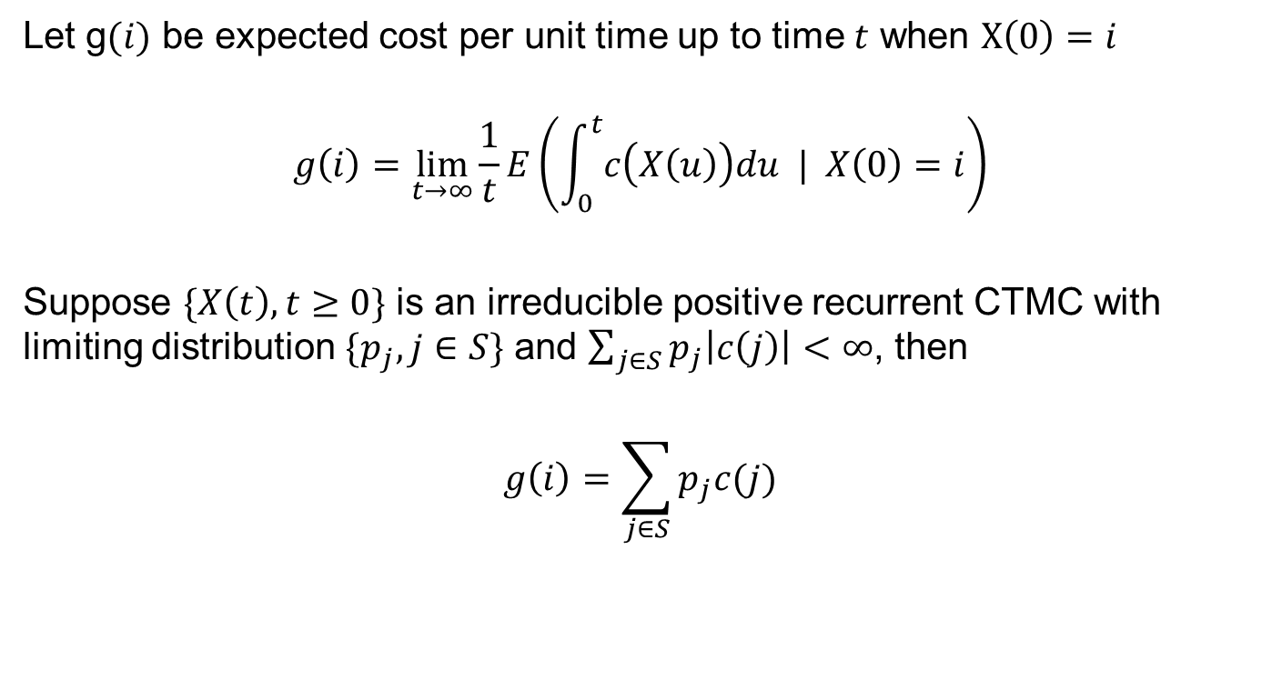
Cost and Rewards
Let g$(i)$ be expected cost per unit time up to time $t$ when $X\left(0\right)=i$
$$g\left(i\right)=\lim_{t→∞}{\frac{1}{t}}E\left(\int_{0}^{t}{c\left(X\left(u\right)\right)du | X\left(0\right)=i}\right)$$
Suppose $\{X\left(t\right),t≥0\}$ is an irreducible positive recurrent CTMC with limiting distribution $\{p_{j},j∈S\}$ and $\sum_{j∈S}{p_{j}\left|c\left(j\right)\right|<∞}$, then
$$g\left(i\right)=\sum_{j∈S}{p_{j}c(j)}$$

Slide 15
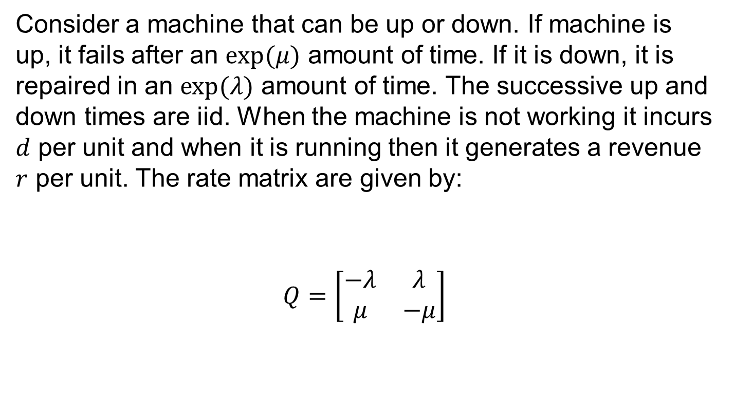
Two-State Machine Example
Consider a machine that can be up or down. If machine is up, it fails after an $exp(μ)$ amount of time. If it is down, it is repaired in an $exp(λ)$ amount of time. The successive up and down times are iid. When the machine is not working it incurs $d$ per unit and when it is running then it generates a revenue $r$ per unit. The rate matrix are given by:
$$Q=\left[\begin{matrix}−λ & λ \\ μ & −μ\end{matrix}\right]$$

Slide 16

Two State Machine Example
The steady state probabilities are given by
$$p_{0}=\frac{μ}{λ+μ}, p_{1}=\frac{λ}{λ+μ}$$
$$g=c\left(0\right)p_{0}+c\left(1\right)p_{1}=\frac{dμ−rλ}{λ+μ}$$

